Slide 1

Department of Computer Science and Engineering
Applying Machine Learning Algorithms for Liver Disease Prediction
PRESENTED BY
D. Satish (21471A0583)
B. Anji babu (21471A0574)
Sk. munaf (21471A05C2)
Under the Guidance of,
K.V.Narasimha Reddy ,
Assistant Professor,
Department of Computer Science and Engineering,
Narasaraopeta Engineering College (Autonomous),
Narasaraopet- 522 601.

Slide 2
OUTLINE
Abstract
Introduction
Literature Survey
Research Gaps
Problem Statement
Objectives
Block Diagram / Flow Diagram
Methodology
Implementation
Results and Analysis
Conclusion & Future Scope
References
Question and Answers
Acknowledgements

Slide 3
ABSTRACT
Liver disease poses a significant global health concern, particularly in countries like India. Early detection is crucial for effective treatment but remains challenging due to the delayed onset of symptoms. This study utilizes various machine learning algorithms to forecast liver disease based on patient data. The models used include Support Vector Machine (SVM), K-Neighbors, Hard Voting Classifier, Multilayer Perceptron, Decision Tree, Logistic Regression, Random Forest, and Genetic Algorithm optimization. Performance metrics such as Accuracy, Precision, Recall, and F1-Score were employed to assess model performance. The Random Forest model optimized with Genetic Algorithm achieved the highest accuracy of 79%, making it the most effective model for liver disease prediction. This approach aids in faster and more accurate diagnoses, enhancing clinical decision-making.

Slide 4
INTRODUCTION
Project Overview: A predictive system for liver disease diagnosis using machine learning models such as Random Forest, SVM, and Multilayer Perceptron.
Motivation: Overcome the challenges of late-stage liver disease diagnosis by leveraging machine learning for early detection.
Importance: Facilitates timely interventions, reducing the burden of liver diseases on patients and healthcare systems.
Relevance: Provides accurate predictions and insights into disease patterns, aiding clinical decision-making and improving outcomes.

Slide 5
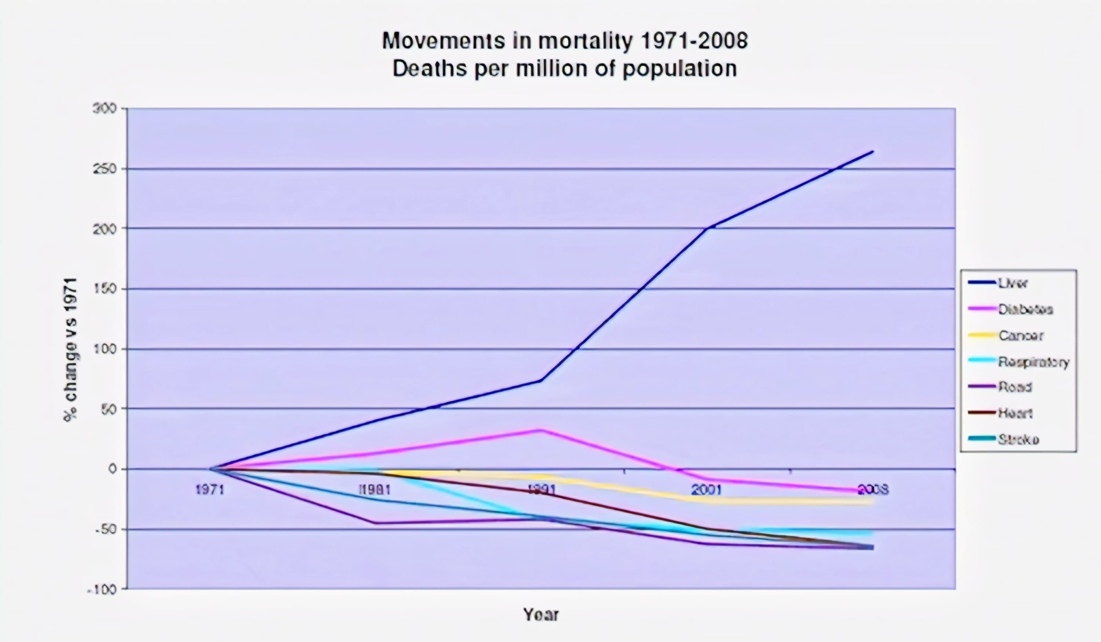

Slide 6
Sharp Increase- Liver disease mortality increased by over 200% from 1971 to 2008,
making it the fastest-growing cause of death.
Rising Trend After 1991- Steady rise in liver disease deaths became more pronounced after 1991.
Contrast with Other Causes- Unlike heart disease, stroke, and respiratory issues, which declined
or stabilized, liver disease mortality surged.
Key Drivers- Increased alcohol consumption, poor diet, and rising cases of
non-alcoholic fatty liver disease (NAFLD) are major contributing factors.

Slide 7
LITERATURE SURVEY
No | Title | Author | Journal Name & Year | Methodology Adapted | Key Findings | Gaps
1 | Enhanced classifier accuracy in liver disease diagnosis using a novel multi-layer feed-forward deep neural network | Sivala Vishnu Murty and R. Kiran Kumar. | International Journal of Recent Technology and Engineering.(2019) | a multi-layer feed-forward deep neural network. | significantly improved the precision of liver disease diagnosis. | No newer optimization techniques such as Genetic Algorithms or other ensemble methods.
2 | Automatic classification of fatty liver disease based on supervised learning and genetic algorithm. | Ahmed Gaber, Hassan A. Youness, Alaa Hamdy, and Ammar M. Hassan. | IApplied Sciences,(2022) | DT,RF and SVM | Genetic Algorithm improved the accuracy | advanced deep learning techniques that could potentially enhance performance.
3 | Computer-aided decision-making for predicting liver disease using PSO-based optimized SVM with feature selection. | Saadatfar Joloudari, Hassannataj Dehzangi, and Shahaboddin Shamshirband. | Informatics in Medicine Unlocked.(2019) | Support Vector Machine | Feature selection enhanced model efficiency | Feature selection enhanced model efficiency
4 | Comparative analysis of machine learning techniques for Indian liver disease patients | Maria Alex Kuzhippallil, Carolyn Joseph, and A. Kannan. | ICACCS(2020). | SVM, DT and RF | RF out performed other models. | id not extensively explore advanced optimization techniques

Slide 8
RESEARCH GAPS
Limited Model Interpretability
Data Imbalance
Generalizability Across Diverse Populations
Overfitting Due to Small Datasets
Real-Time and Longitudinal Data Analysis
Focus on Accuracy Over Clinical Applicability

Slide 9
PROBLEM STATEMENT
Liver disease poses a significant global health challenge, with early detection hindered by late symptom onset. This study applies machine learning models like SVM, Random Forest, and Multilayer Perceptron, optimized with Genetic Algorithms, to enhance diagnostic accuracy. The approach aims to improve early detection and support clinical decision-making for better patient outcomes.
Significance:
Life-Saving Potential: Early detection reduces mortality and long-term costs.
Transparent Insights: Helps professionals understand key risk factors

Slide 10
OBJECTIVES
Develop a Reliable Liver Disease Prediction Model to accurately classify age of the patients over 40-50 years of age
It Enhance the SVM ,KNN Model Interpretability for the existing system
Address Class Imbalance Issues of the age and gender
Evaluate Real-World Applicability

Slide 11
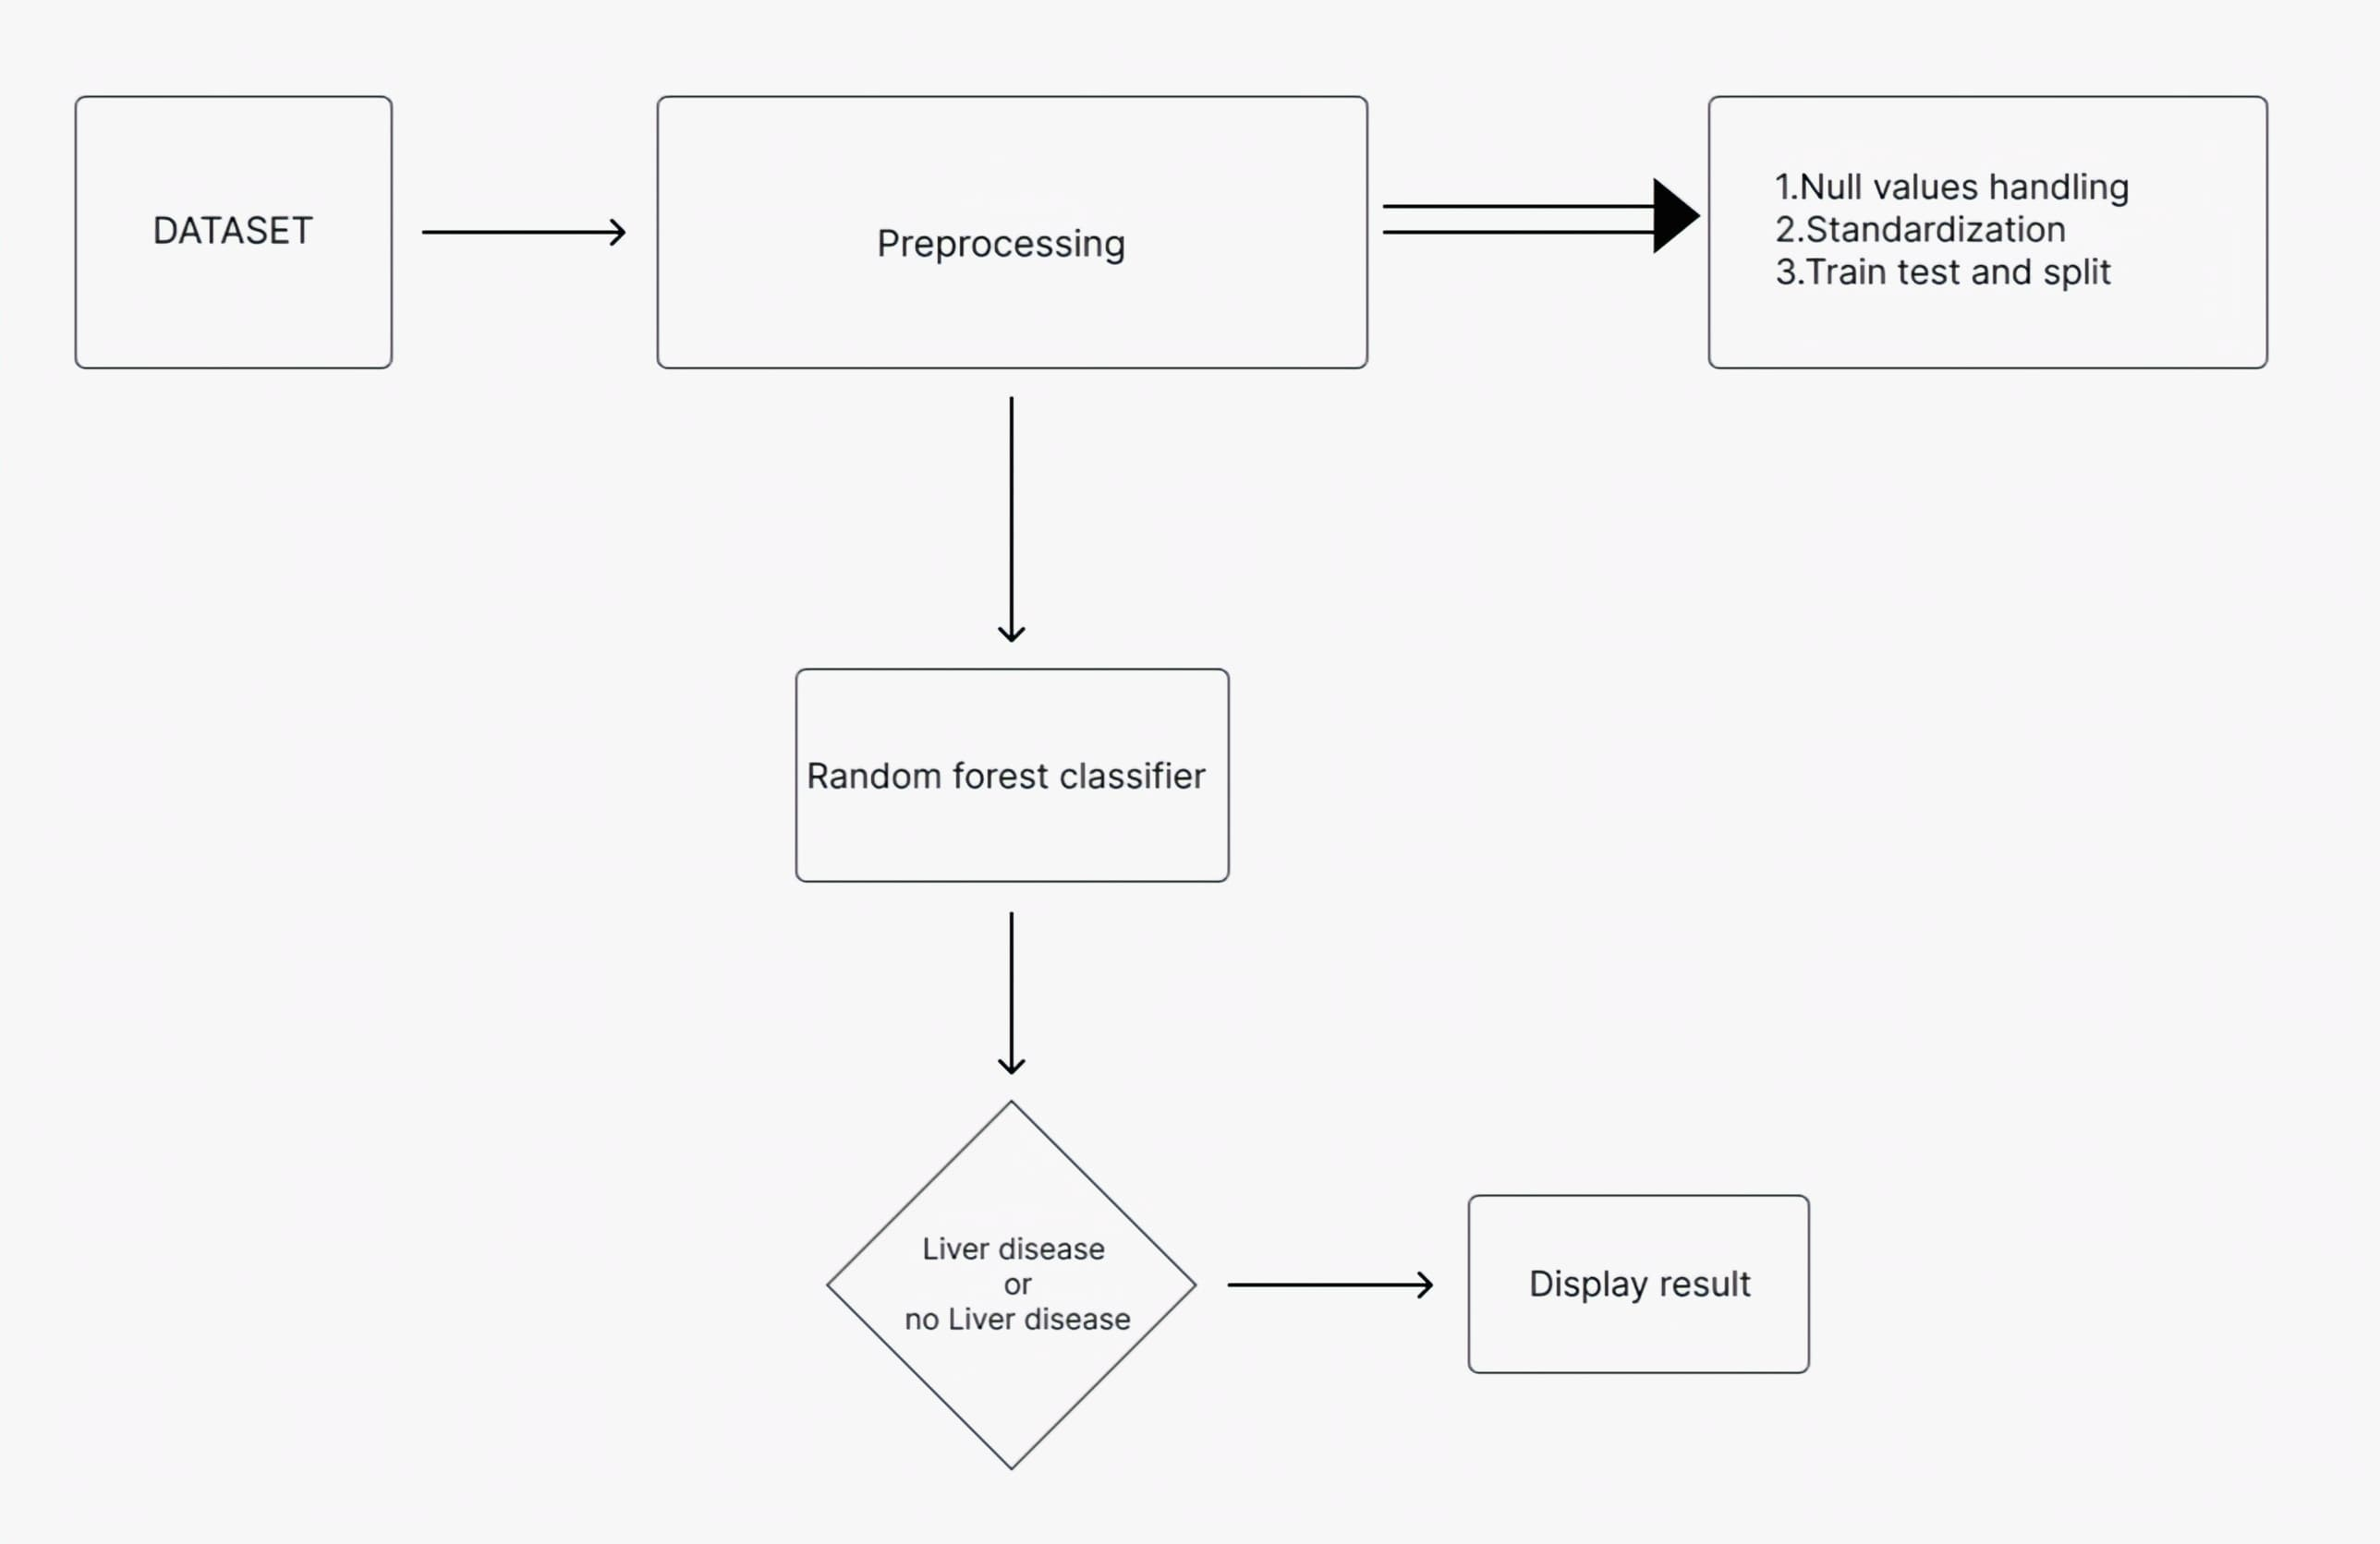
BLOCK DIAGRAM OR FLOW DIAGRAM

Slide 12
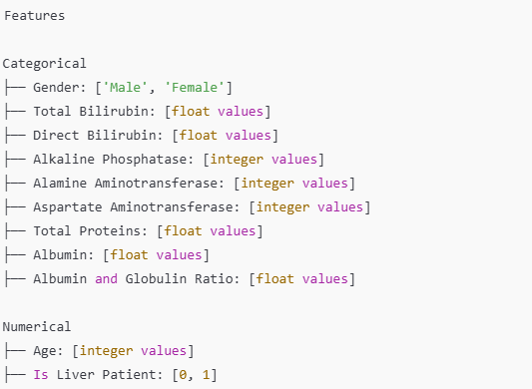
METHODOLOGY
Data Set:
Source: Kaggle
(Stroke Prediction Dataset)
Size: 583 records, 11 features
Target Variable: Dataset
(1: Liver patient,
2: Non Liver patient)

Slide 13
Preprocessing:
Data Cleaning:
Removal of irrelevant columns.
Conversion of nominal and categorical features (e.g., gender) into numerical variables.
Handling missing fields and null values using the KNN imputation technique to ensure accuracy and reliability.
Normalization:
Scaling of features to achieve a standard normal distribution with a mean of 0 and a standard deviation of 1.
Standardization reduces differences in the range of features, simplifies model building, and helps choose appropriate activation functions for algorithms like perceptron.

Slide 14
Data Standardization and Visualization:
Transforming data into a structured and consistent format for easier classification and analysis.
Eliminating noise and inconsistencies to enhance dataset usability.
Feature Engineering:
Standardizing the dataset for consistency.
Applying cleaning techniques to prepare the dataset for machine learning models.

Slide 15
Model Selection and Development:
Data Set
1. Genetic Algorithm
An optimization algorithm used for feature selection and hyperparameter tuning.
Improves accuracy by selecting features and parameters with the best fitness score.
Enhances model performance, particularly in RF and Logistic Regression, leading to a significant improvement in prediction metrics .
2. Random Forest
Optimizes hyperparameters for a Random Forest classifier to classify liver disease.
High accuracy and recall, indicating a well-balanced model for liver disease prediction.
Achieves 79% accuracy, 81% precision, 94% recall, and an F1 Score of 0.87.

Slide 16
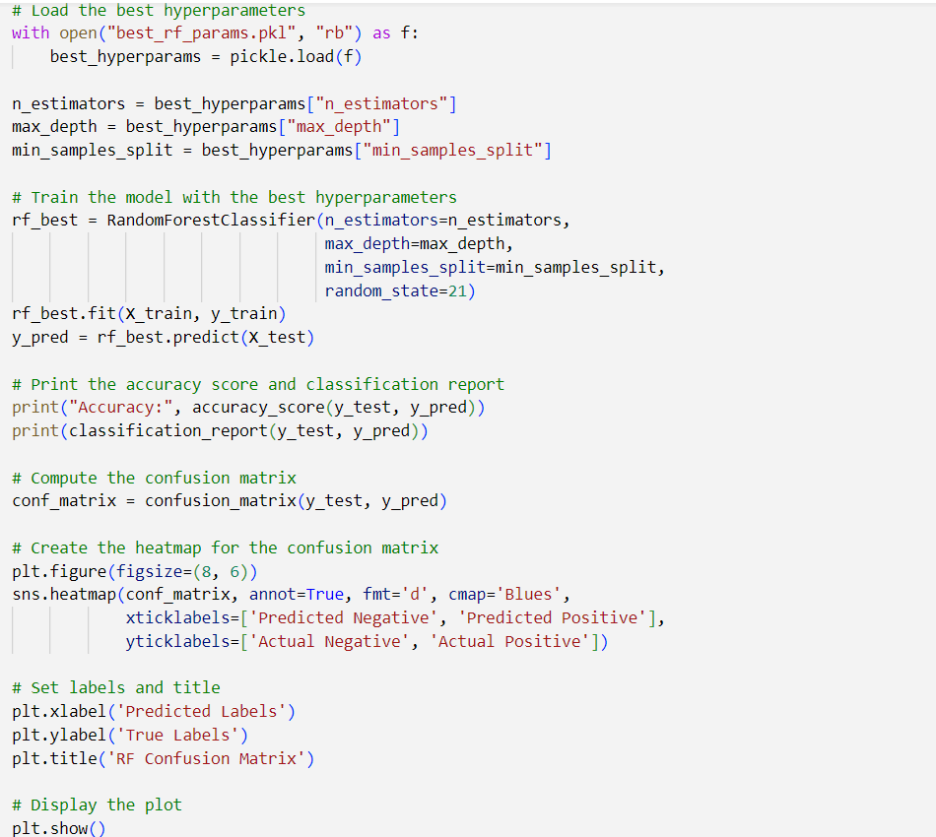
IMPLEMENTATION
Data Set

Slide 17
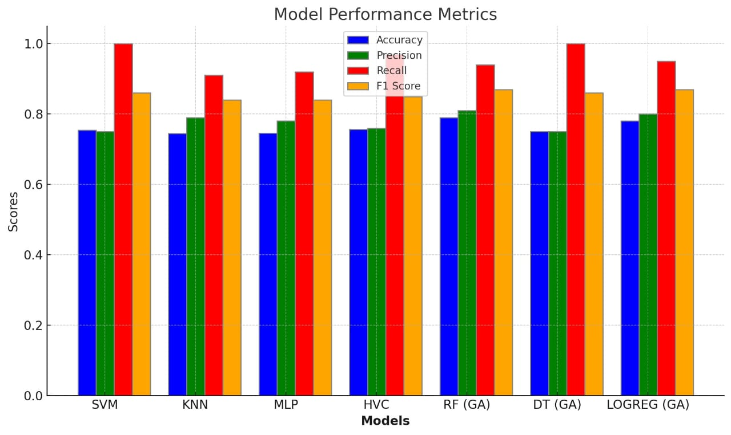
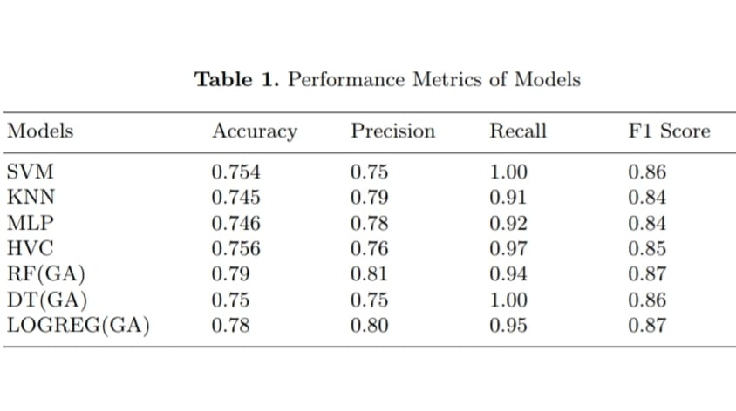
RESULTS & ANALYSIS

Slide 18
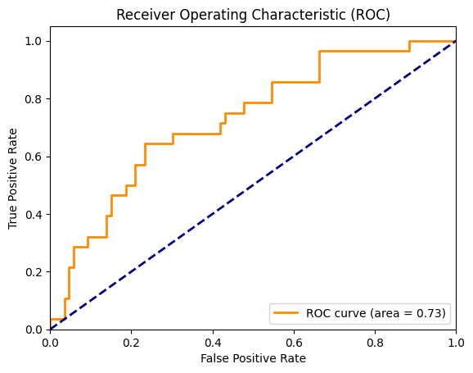
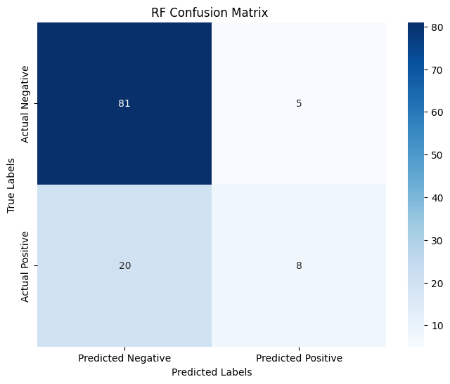
Performance Assessment via ROC Curve
Confusion Matrix for RF Model

Slide 19
CONCLUSION and FUTURE SCOPE
Conclusion:
Developed a liver disease prediction model using machine learning algorithms like Random Forest, SVM, and Multilayer Perceptron.
Data preprocessing, including cleaning, normalization, and feature selection with Genetic Algorithms, enhanced model performance.
Achieved 79% accuracy with Random Forest optimized by Genetic Algorithm, demonstrating the highest effectiveness among tested models.
The approach aids early detection of liver diseases, supporting timely interventions and improved clinical decision-making.
Future Work:
Extend the dataset to include a larger and more diverse population.
Explore deeper learning architectures for enhanced prediction accuracy.
Investigate additional optimization techniques to refine model performance.
Implement more sophisticated feature selection and data handling strategies

Slide 20
REFERENCES
[1] KV Narasimha Reddy, SN Tirumala Rao, and K. S. M. V. Kumar. "Diabetes Prediction using Extreme Learning Machine: Application of Health Systems." In 2023 5th International Conference on Smart Systems and Inventive Technology (ICSSIT), pp. 993-998. IEEE, 2023.
[2] Devarbhavi, Harshad, Sumeet K. Asrani, Juan Pablo Arab, Yvonne Ayerki Nartey, Elisa Pose, and Patrick S. Kamath. "Global burden of liver disease: 2023 update." Journal of Hepatology 79, no. 2 (2023): 516-537.
[3] Anthonysamy, Victor, and SK Khadar Babu. "Multi Perceptron Neural Network and Voting Classifier for Liver Disease Dataset." IEEE Access (2023).
[4] Dutta, Krittika, Satish Chandra, and Mahendra Kumar Gourisaria. "Early-Stage detection of liver disease through machine learning algorithms." In Advances in Data and Information Sciences, pp. 155-166. Springer, Singapore, 2022.
[5] Moturi, Sireesha, Jhansi Vazram Bolla, M. Anusha, M. Mounika Naga Bhavani, Srikanth Vemuru, SN Tirumala Rao, and Sneha Ananya Mallipeddi. "Prediction of Liver Disease Using International Conference on Data Science and Applications." In Data Science and Applications, pp. 243-254. Singapore: Springer Nature Singapore, 2023.
[6] Murty, Sivala Vishnu, and R. Kiran Kumar. "Enhanced classifier accuracy in liver disease diagnosis using a novel multi-layer feed-forward deep neural network." International Journal of Recent Technology and Engineering 8 (2019): 1392-1400
[7] Haque, Md Rezwanul, Md Milon Islam, Hasib Iqbal, Md Sumon Reza, and Md Kamrul Hasan. "Performance evaluation of random forests and artificial neural networks for the classification of liver disorder." In 2018 International Conference on Computer, Communication, Chemical, Material and Electronic Engineering (IC4ME2), pp. 1-5. IEEE, 2018.

Slide 21
REFERENCES
[8] Joloudari, Saadatfar, Javad Abdollah Hassannataj, Dehzangi, Hamid and Shahaboddin Shamshirband. "Computer-aided decision-making for predicting liver disease using PSO-based optimized SVM with feature selection." Informatics in Medicine Unlocked 17 (2019): 100255.
[9] Gaber, Ahmed, Hassan A. Youness, Alaa Hamdy, Hammam M. Abdelaal, and Ammar M. Hassan. "Automatic classification of fatty liver disease based on supervised learning and genetic algorithm." Applied Sciences 12, no. 1 (2022): 521.
[10] Kuzhippallil, Maria Alex, Carolyn Joseph, and A. Kannan. "Comparative analysis of machine learning techniques for Indian liver disease patients." In 2020 6th International Conference on Advanced Computing and Communication Systems (ICACCS), pp. 778-782. IEEE, 2020
[11] Gupta, Ketan, Nasmin Jiwani, Neda Afreen, and D. Divyarani. "Liver disease prediction using machine learning classification techniques." In 2022 IEEE 11th International Conference on Communication Systems and Network Technologies (CSNT), pp. 221-226. IEEE, 2022.
[12] Musleh, Musleh M., Eman Alajrami, Ahmed J. Khalil, Bassem S. Abu-Nasser, Alaa M. Barhoom, and SS Abu Naser. "Predicting liver patients using artificial neural network." International Journal of Academic Information Systems Research (IJAISR) 3, no. 10 (2019).
[13] Indian liver patient dataset."https://www.kaggle.com/datasets/ jeevannagaraj/ indian-liver-patient-dataset"
[14] Moturi, Sireesha, Jhansi Vazram Bolla, M. Anusha, M. Mounika Naga Bhavani, Srikanth Vemuru, SN Tirumala Rao, and Sneha Ananya Mallipeddi. "Prediction of Liver Disease Using Machine Learning Algorithms." In International Conference on Data Science and Applications, pp. 243-254. Singapore: Springer Nature Singapore, 2023.
[15] Mamidala, Sai Kumar, Sireesha Moturi, SN Tirumala Rao, Jhansi Vazram Bolla, and KV Narasimha Reddy. "Machine Learning Models for Chronic Renal Disease Prediction." In International Conference on Data Science and Applications, pp. 173-182. Singapore: Springer Nature Singapore, 2023

Slide 22
QUESTIONS and ANSWERS

Slide 23
ACKNOWLEGEMENTS
Gratitude to the faculty and mentors at NEC for their guidance and support.
Appreciation for the access to the Indian Liver patient Dataset, which was critical for the project.
Thanks to the open-source community for providing resources and pre-trained Machine Learning models.
Acknowledgment of team members for their collaboration and dedication throughout the project.
Special thanks to [K.V.Narasimha Reddy and M.Sireesha] for their valuable inputs and assistance.

